Slide 1
Problem Solving Techniques
BY PRAPHUL

Slide 2
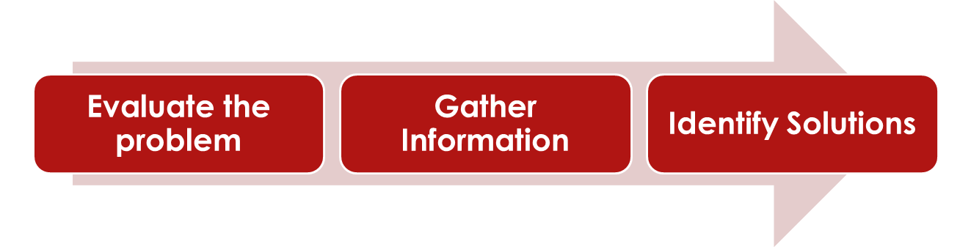
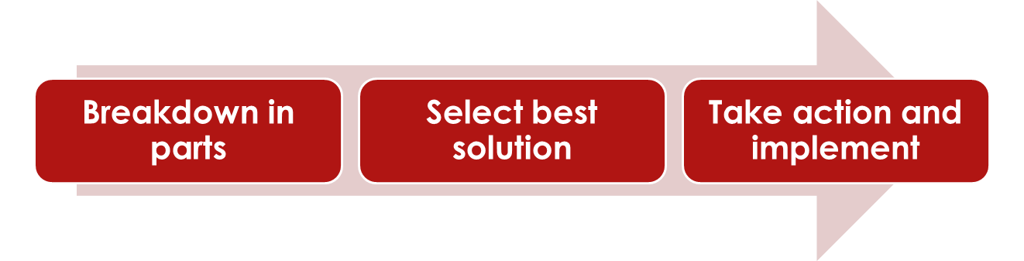
Problem Solving

Slide 3
Characteristics of Difficult Problem
Lack of clarity
Multiple Goals
Multiple Items and Decisions
Time

Slide 4
Creativity vs Innovation
Creativity is about unleashing the potential of the mind to conceive new ideas. However, creative ideas can also be thought experiments within one person’s mind.
Creativity is subjective, making it hard to measure, as our creative friends assert.
Innovation, on the other hand, is completely measurable. Innovation is about introducing change into relatively stable systems.
An organization can use innovation to apply its creative resources to design an appropriate solution and reap a return on its investment.
Organizations often chase creativity, but what they really need to pursue is innovation.

Slide 5
Finding creative Solutions
Critical thinking and information analysis
  Think through different angles and analyse available information
Brainstorming, Reverse Brainstorming, Mind Mapping
  Brainstorm on idea in group of experts and prepare mind map of various parts/modules
Collaboration, Communication and Creativity Skills

Slide 6
Finding creative Solutions
Analysing the situation, Gathering information, Identifying solution criteria
Decision Making
Charts and Diagrams
oApplying outcome‐based thinking

Slide 7
Analyzing real life problems
Need to form team of two students and solve the problem with problem solving techniques

Slide 8
Evaluation and Selection of solution
Feasibility/Capability Analysis
Choosing among alternatives
Qualitative analysis and qualitative analysis – Scalability, Concurrency, Load Handling
Establishing objectives – Decide the
goals
Assigning weight to objectives in order to make the best decision
Creating a satisfaction scale to choose between alternatives

Slide 9
Implementing Decisions
Prepare Action Plan
Break solution into action steps
Prioritize actions and assign roles (setting priorities for taking action)
Follow‐up at milestones and track the progress

Slide 10
Non Functional Aspects of Solutions
Architecture
Scalability
Security
Deployment
Compliance
Interoperability
Maintainability
Portability
Extensibility
Performance
Reusability
Stability
Testability
Failure Management
Configuration Management
Accessibility
Price

Slide 11
Thank You

